Slide 1
Use AI To Make Your Data Job Easier (and More Fun)
Matt Gordon
Data Saturday Oslo – August 31, 2024

Slide 2










Thank you to our sponsors

Slide 3

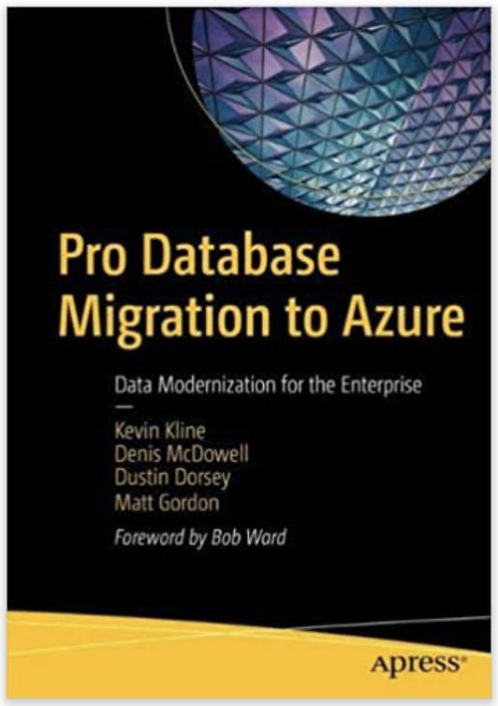
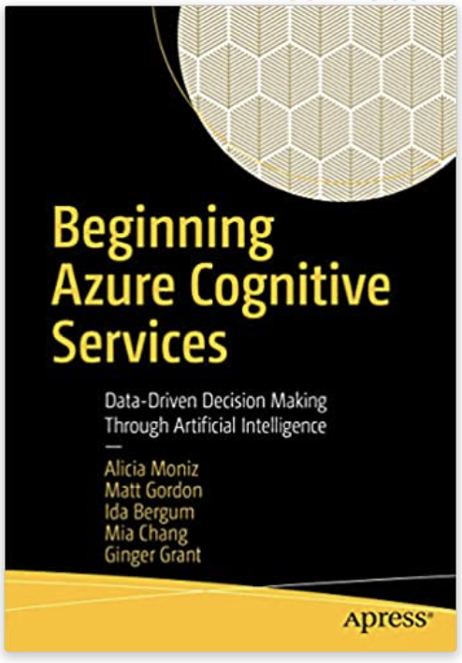


Matt Gordon
Senior Architect
matt@sqlatspeed.com
: @sqlatspeed
www.sqlatspeed.com

Slide 4
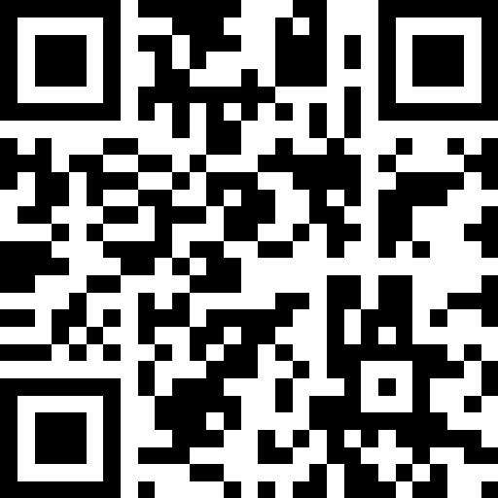
Session Evaluation
https://eval.datasaturday.no/138352318556881

Slide 5


About Me
20+ years of on-prem/cloud SQL experience
Microsoft Data Platform MVP
Redgate Ambassador
Led cloud migrations large and small
Worked on Azure AI since 2017
Leader of Lexington, KY (USA) Data Technology Group
Notes:
“So let’s talk about what AI is…”

Slide 6

About Me
Notes:
4157 miles from home (6690 km)

Slide 7
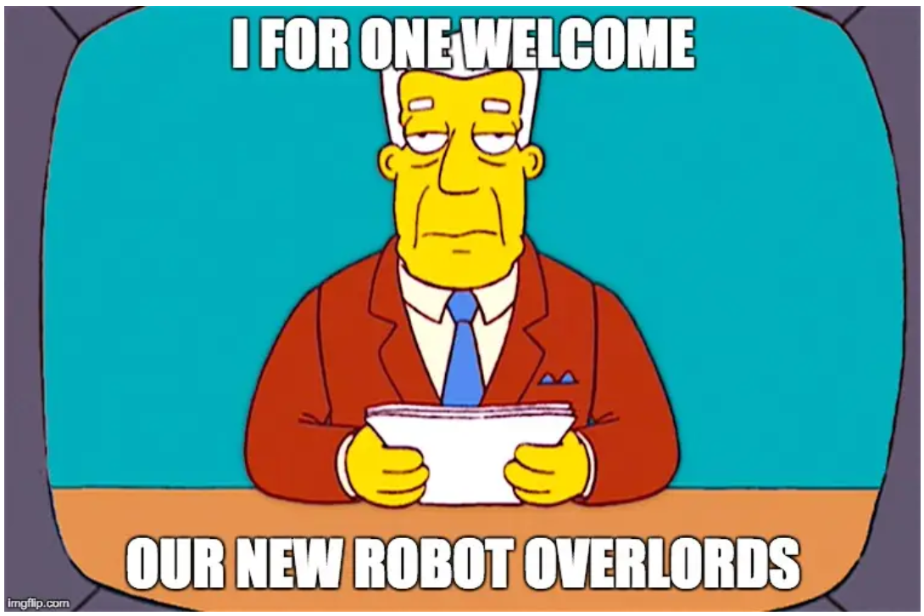

Slide 8
What Is AI (and What Isn’t It)?
The media says it’s ChatGPT
Some people say it’s a lot of hype
My son said “it’s just a bunch of if/then statements that run really fast”
Oxford Languages says it’s “the theory and development of computer systems able to perform tasks normally requiring human intelligence, such as visual perception, speech recognition, decision-making, and translation between languages.”
Notes:
So what do we think it is?

Slide 9
What Is AI To Data People?
It’s Copilot experiences in our development environments
It’s a robot tuning our code and our developers’ code
It’s ChatGPT helping us program in a language we don’t know or breaking coder’s block if we’re stuck
It’s enabling accessibility for people who have physical challenges to typing and other actions
It’s an annoyance – maybe our manager thinks they don’t’ need us anymore because “the AI” will do it all
Notes:
Bullet 4 is time to mention Steve Hughes and Data on Wheels (mention ALS walk fundraising campaign)
Maybe it’s all (or most) of this?
So then, how do we use it…?

Slide 10
Azure Cognitive Services
Speech
Language
Translator
Vision
Azure OpenAI
Rebranding over time (quickly) as Azure AI
Notes:
THESE PAGES CHANGED A COUPLE DAYS AGO
Discuss Azure Cognitive Services…and as this stuff slowly rebrands into Azure AI after $13 billion invested in OpenAI since 2019
Refer to web page and cite examples of each service
Note that Speech, Language, and Vision have “studios” that will be linked on the resources page
Point out that there are some good quickstarts through Microsoft Learn as well
Note that Amazon has similar technologies but my background is with MS and, with OpenAI, they seem to have the advantage right now

Slide 11
How Can I Use Azure AI APIs?
Logic Apps
Power BI
Power Apps
Power Automate
Studio “experiences”
REST API calls
Notes:
Mention NLP capabilities of Power BI
After explaining these, note that nearly all of them are low-code/no-code experiences
Set up “QnAMaker” demo by noting that boss has asked their employees to “use AI” to speed the new employee onboarding experience because people are spending too much time being friendly…

Slide 12

AI-Powered New Employee Welcome Bot
Image credit: FOX/Comedy Central
Notes:
Walk audience through how it was built
Don’t forget to point out the real world applications of this (ask audience for their ideas) and these tools work together more and more each day

Slide 13

Copilot in Azure Data Studio
Image credit: Alamy
Notes:
Note how modern this company is that our database is from 2008
Walk through some query building
Walk through some index suggestions
Walk through some suggested “answers” (like how many people live in Seattle from the Person.Address table)
Review installation of an extension in ADS and licensing

Slide 14

AI Responds to Angry Emails with Power Automate
Image credit: DriveTribe Facebook/BBC
Notes:
Run the flow (after turning it on)
Walk them through the flow
Mention that Copilot gets the assist here because the “old” way of doing it is much more complex now
Note that there is a free tier but to get the full goodness the paid tier is where it’s at (your company likely has some/all of this as part of Office 365)

Slide 15

AI Writes “A Song”…and Performs It?
Image credit: Getty Images/iStockPhoto
Notes:
We’re not happy at our new job…so we asked ChatGPT to write a “song” about our DBA
Speech Studio “performs” the song – ask the crowd to give respect to the performer ;-)
Show the SSML and note that this can all be API calls from chat bots like we showed earlier (that’s more advanced stuff)…but we can convey emotion in spoken communication

Slide 16

ChatGPT, Meet My Database
Image credit: New Line Cinema
Notes:
ChatGPT talks to my database and generates content
Brian Spendolini and Buck Woody from MS are demoing cool stuff here and just imagine the possibilities
Imagine using this to take a first swing at a data dictionary…or a narrative around a data warehouse model for executive approval at a large firm

Slide 17
Database, Meet ChatGPT
Image credit: New Line Cinema
Notes:
Mention blog is on reference slide but that it took A LOT of customization and more work can be done
Also mention how easily text to speech and speech to text could be turned on (PLAYGROUND SETTINGS)

Slide 18
What Comes Next?
Deploy Copilot from chat playground in OpenAI Studio
Vector Search in Azure SQL Database
RAG (Retrieval Augmented Generation) calling OpenAI from Azure SQL Database
Refines LLMs with external data from our database
Something we haven’t heard of yet…
Notes:
Mention session at FabCon Europe where I will get into more 200-level things

Slide 19
How Will AI Impact Data People?
It can help us do our jobs
Conversation bots to handle mundane and/or repeated questions
Copilot experiences in ADS and other tools
Automated responses to tickets, emails, etc.
Create our own data dictionaries using the power of LLMs?
ChatGPT-style conversations over our data
We’re already surrounded by it
This session will change every time I present it – that’s the speed of development in this space
It’s overhyped, but don’t dismiss it – engage with it (and maybe have a little fun)

Slide 20
Resources
Buck Woody’s generative AI session
Copilot for Azure Data Studio
GitHub Copilot in Azure Data Studio – Warwick Rudd’s presentation
Language Studio
Speech Studio
Vision Studio
Brian Spendolini’s Azure SQL/OpenAI blog
Buck Woody’s Azure SQL/OpenAI Azure Data Studio blog
Chat with your data in Azure SQL Database

Slide 21
The Slide Where I Sell My Books
Cognitive Services book
Database Migration book

Slide 22
Session Evaluation
https://eval.datasaturday.no/138352318556881

Slide 23
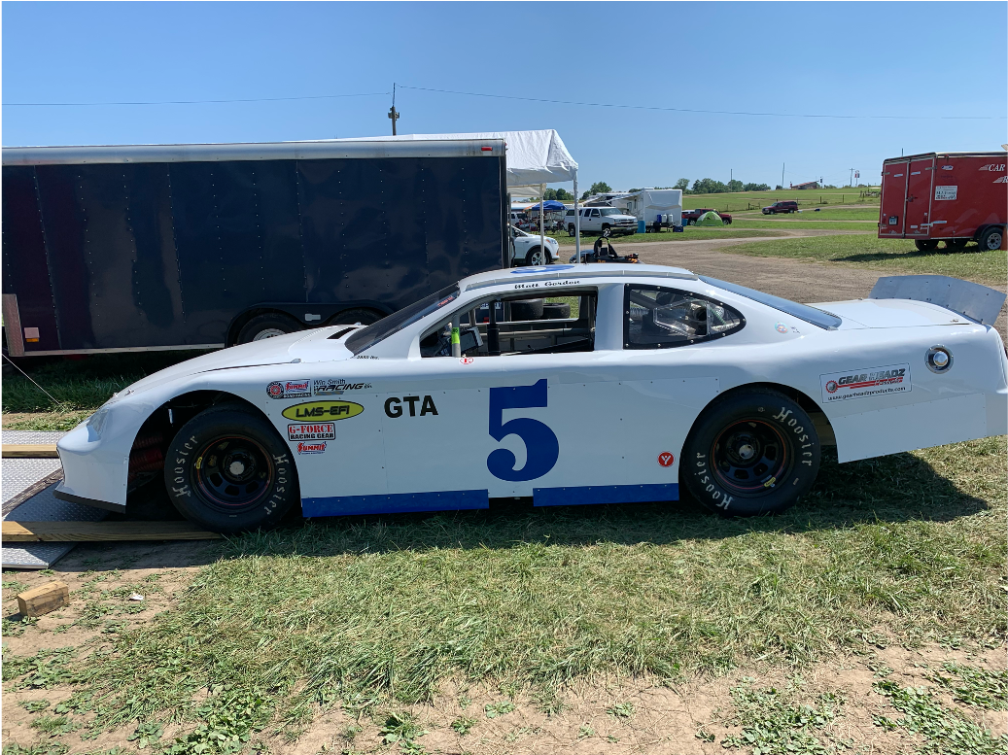
Thanks For Attending!
Matt Gordon
Senior Architect
matt@sqlatspeed.com
: @sqlatspeed
www.sqlatspeed.com
https://github.com/sqlatspeed/2024_presentations

Slide 24
Presentation Outline
What is AI (and what isn’t but may say it is)?
It’s not all ChatGPT, but some of it is
Brief history of Azure AI/Cognitive Services
Discussion of low code/no code methods for accessing these
X-DEMO: Show what happened to QnAMaker and how it can help you now
X-DEMO: Azure Data Studio (soapbox!) and Copilot experience in ADS (can be better)
X-DEMO: Power Automate to respond to email (maybe bundle sentiment analysis in here)
Talk about sentiment analysis in Cognitive Services as a way of gauging social media reaction (but this uses AI Builder)
Review language, vision, and speech studio if people just want to play (organize in one browser window)
Note-taking in meetings is a great personal example in Teams
X-DEMO: ChatGPT writes a song about the mean DBA from earlier (and then Speech studio gives it a dramatic reading)
Discussion of how that will affect our job roles (will it replace, will it modify, etc.)
Add resources slide with Buck’s talk, links to new QnAMaker, copilot docs for ADS, Language/Vision Studio quickstarts and other resources
Buck/Twitter like OpenAI demo for Minnesota and other 60-minute versions

